Slide 1
Parish Survey and Profile
Search Committee

Slide 2
Survey Purpose
To ensure the congregation’s voice is reflected in the Profile

Slide 3
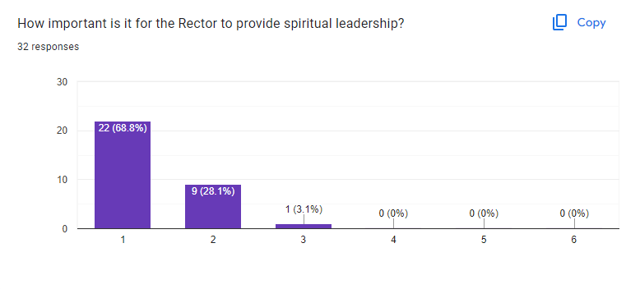
Priority Score 1.30
54
18
Paper
Web
1
2
Very High Priority

Slide 4
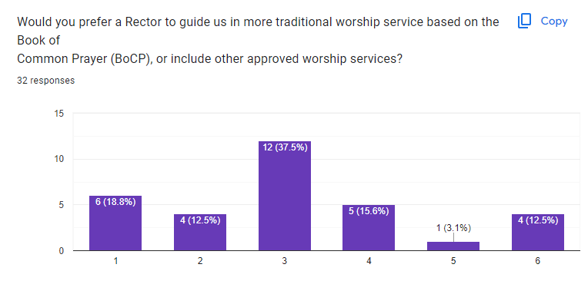
Priority Score 3.12
54
16
9
11
5
1
4
No Clear Preference

Slide 5
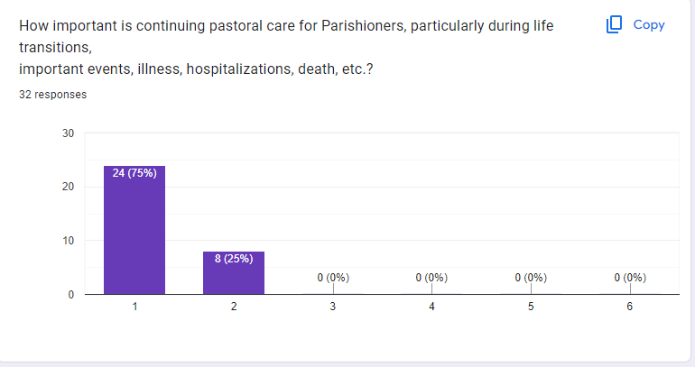
Priority Score 1.20
51
15
3
Highest Priority Along With Spiritual Leadership

Slide 6
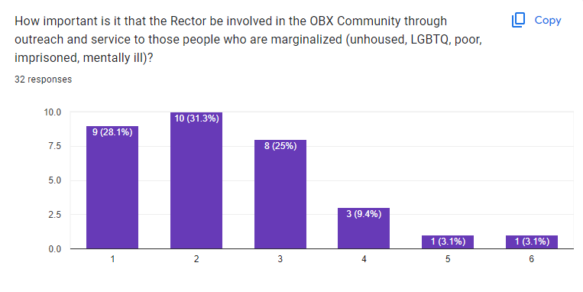
Priority Score 2.33
52
14
14
12
4
2
1
Important, but Not Top Priority

Slide 7
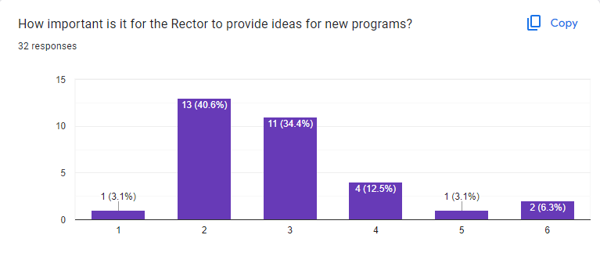
Priority Score 2.81
52
6
6
4
2
1
3
Important, but Not Top Priority

Slide 8
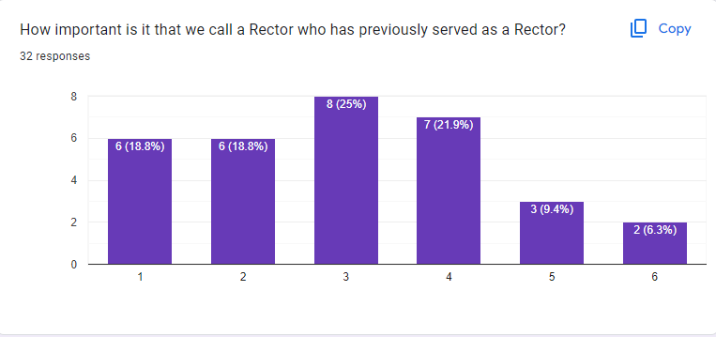
Priority Score 2.81
53
6
7
1
3
2
4
Experience Helps, but Isn’t the Most Important Factor

Slide 9
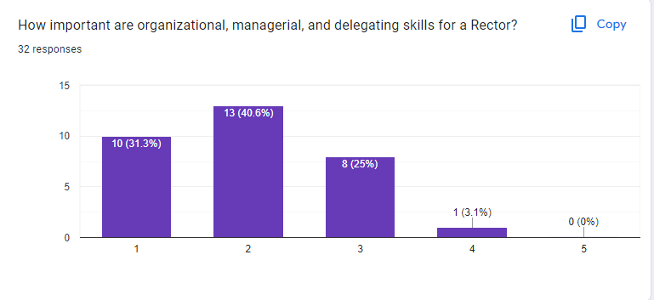
Priority Score 2.10
52
10
5
3
2
Important, but Not Top Priority

Slide 10
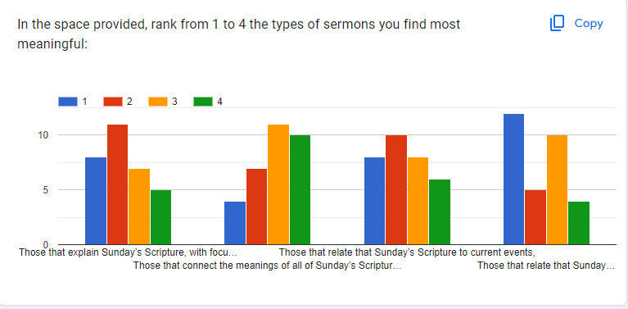
Ranked Highest or Second:
Focus on Gospel (30 times)
Connect meanings of scripture readings (25)
Relate scripture to current events (31)
Relate scripture to your life (30)
Inspiring Sermons Often Include Several Types

Slide 11
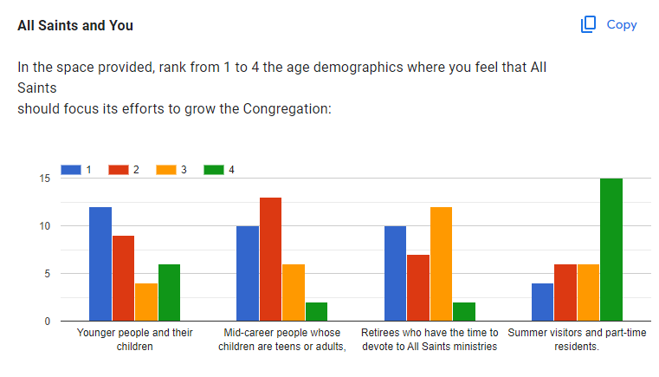
Ranked Highest or Second:
Younger people and children (32 times)
Mid-career (40)
Retirees (27)
Summer visitors and part-time residents (12)
All Growth is Good, Mid-Career as Top Focus

Slide 12
Question #10: What is the MOST important reason YOU attend All Saints vs. another church?
The most common response was how “Welcoming and Friendly” the people of are, and how All Saints is a “family”
Close seconds were:
What All Saints accomplishes with “Outreach”
Worship services; the liturgy, the music, and the choir
“Open-Hearted, Open-Minded” inclusiveness

Slide 13
Question #11: What things does All Saints need to do more of, do less of, or should stop doing?
More
Growth (said in many different ways)
Pastoral care
Recruit volunteers for all ministries
Small group activities
Communication
Combined services
Less
Filling the Narthex with sign-up sheets: go electronic
Make worship less “stodgy” and more “dynamic”
“Lighten up on the Old Testament”
Using “outside voices” while inside the sanctuary
Stop
Just “keep doing what we’ve always done” and expect things to change
Politics from the pulpit
Letting cell phones ring during services

Slide 14
Question #12: What is your vision of All Saints five years from now?
“Growth” and “greater age diversity” were by far most common responses
Also mentioned frequently were:
Continue as a vibrant, loving, inclusive congregation
Maintain our dedication to community and outreach
“Inreach” and pastoral care

Slide 15
What Did the Search Committee Learn?
ESSENTIAL:
Pastoral Care and Worship (Spiritual Leadership) are the most important qualities for prospective Rectors
VERY IMPORTANT:
Prospective Rector’s commitment to outreach and management skills are important
The quality of the sermon is more important than which portion of the scripture is the focus
Track record in growing a worship community
TO BE CONSIDERED:
That the Rector have new ideas, experience in Parish leadership, and preferences for specific worship service formats

Slide 16
How Are Survey Results Reflected in the Profile?
Five priorities identified by the survey guided the Search Committee
Worship (spiritual leadership)
Pastoral Care
Growth
Outreach
Inclusion
Everything we wrote in the Profile reflected one or more of these priorities
Who we are as All Saints
The desired skills and characteristics of a prospective Rector
Where we need our next Rector to lead us as we walk hand-in-hand toward the future

Slide 17
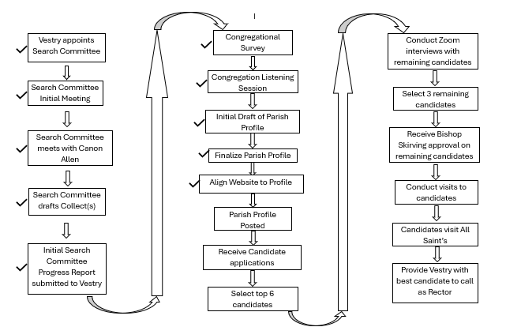
Search Status
Profile completed by Search Committee and approved by Vestry
Website remodeled and updated to reflect Profile
Goes live tomorrow
Transition tab
Our Story
Progress chart
Collects
Profile
Profile to be posted this week and available to all Episcopal clergy

